Slide 1
KINGSTON SCHOOL OF MANAGEMENT AND SCIENCE
TOPIC:COTTAGE CRAFT
DEPARTMENT:- BCA 5th Sem
GROUP -D
STUDENT NAME ROLL NO
RUDRAPIYA MAITY 17301221027
RAJIB MAHTA 17301221048
AROHI TALUKDER 17301221033
NOUSAD ANSARI 17301221043
DEBORSHI NATH 17301221047

Slide 2
INTRODUCTION
Welcome to our Cottage Craft Haven, an enchanting e-commerce destination where craftsmanship meets convenience. Explore a curated collection of handmade treasures, each telling a unique story. Elevate your living with the charm of artisanal wonders.

Slide 3
TECHNOLOGY USE
01
02
03
04
05
06
Vs Code
Node js
Brave browser
Firefox
Mongodb compus
Mangodb atlas

Slide 4
Navbar section

Slide 5
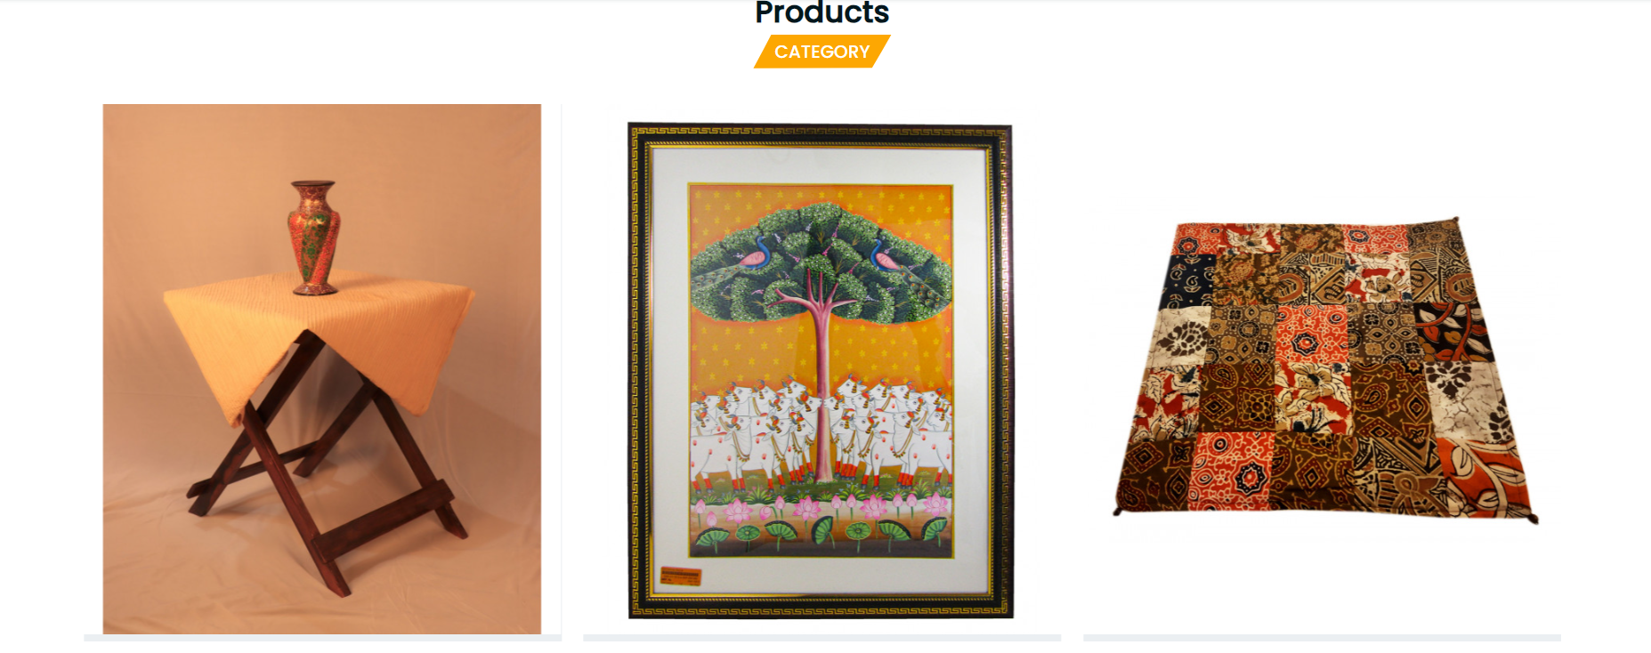
Category section

Slide 6
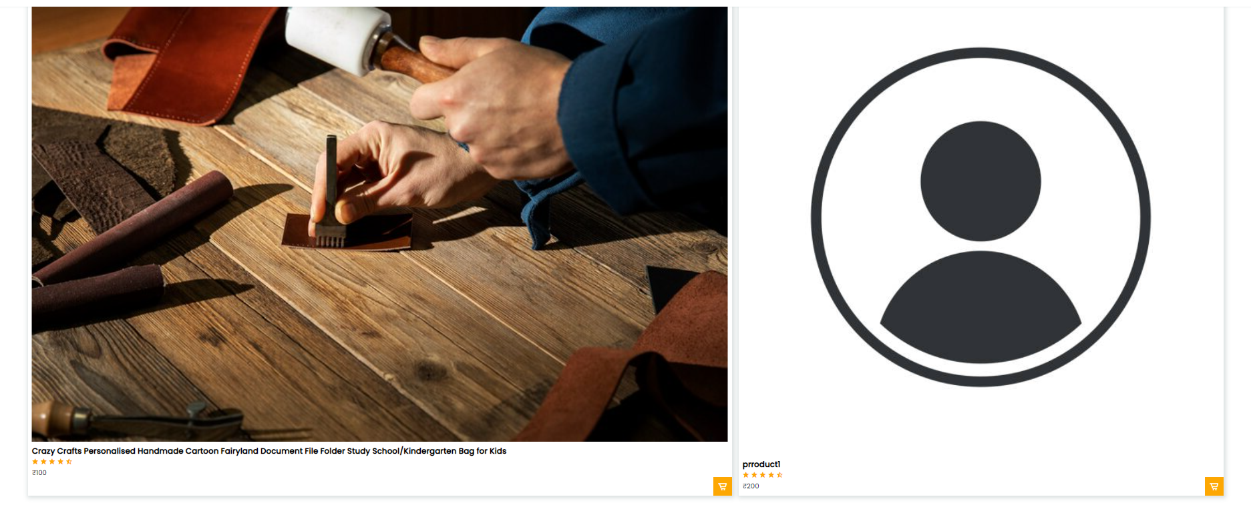
Product section

Slide 7
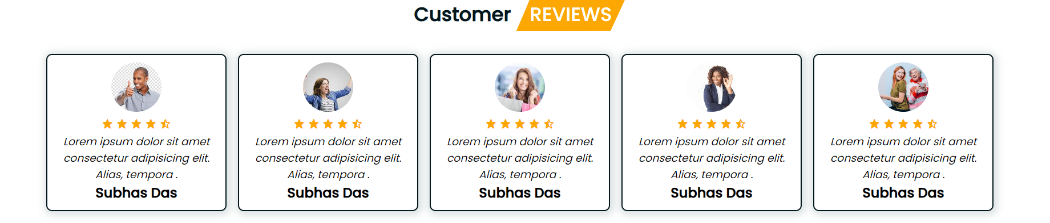
Review section

Slide 8
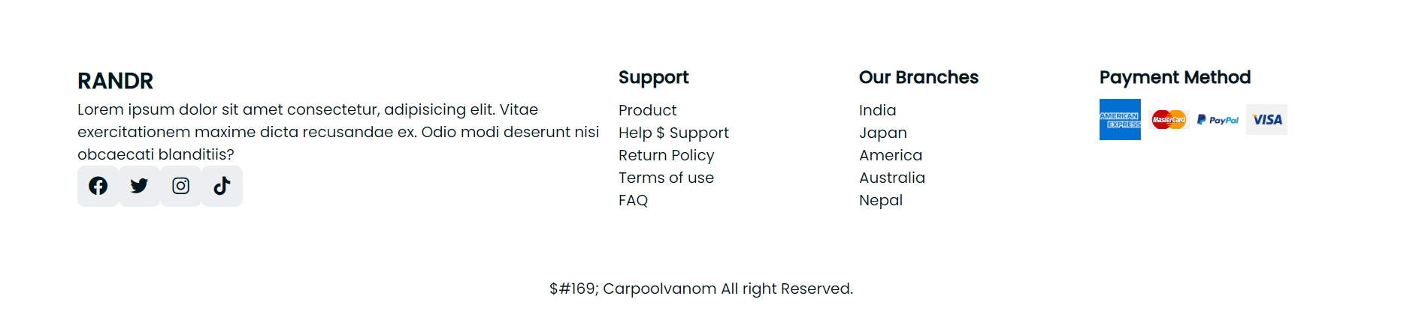
Footer section

Slide 9
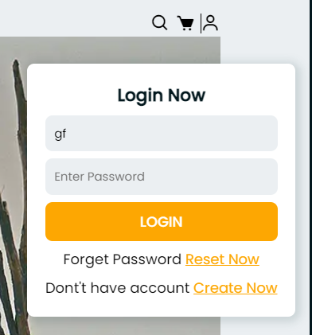
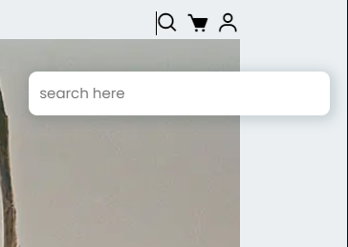
Search and login page

Slide 10
Solutions
Navbar:- its contains multiple section of this project like : logo , signup page, search bar, checkout section etc.
Category:- In this section contains multiple types of product category.
Review:- In this section we contains customer Review.
Footer:- its contains our branches , payment method , and Support.

Slide 11

HOME PAGE

Slide 12
Above this home page we advertise our new upcoming product and mention here how much discount over a product. Special reason to create this section for attractive customer and update daily to cheek new product.

Slide 13
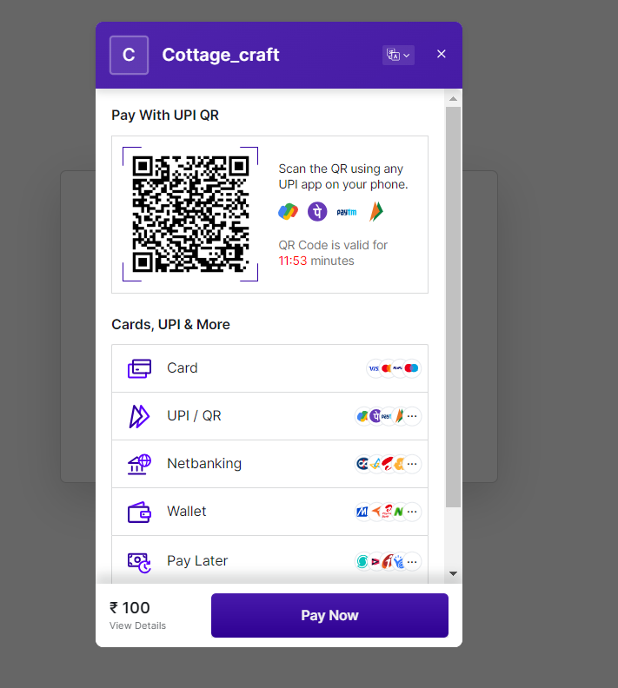
Payment page

Slide 14
According to our payment method we allow cash of delivery. In case of online method customer can use card , UPI , net banking wallet . If any transaction problem from us it will solved within 7 working days.

Slide 15
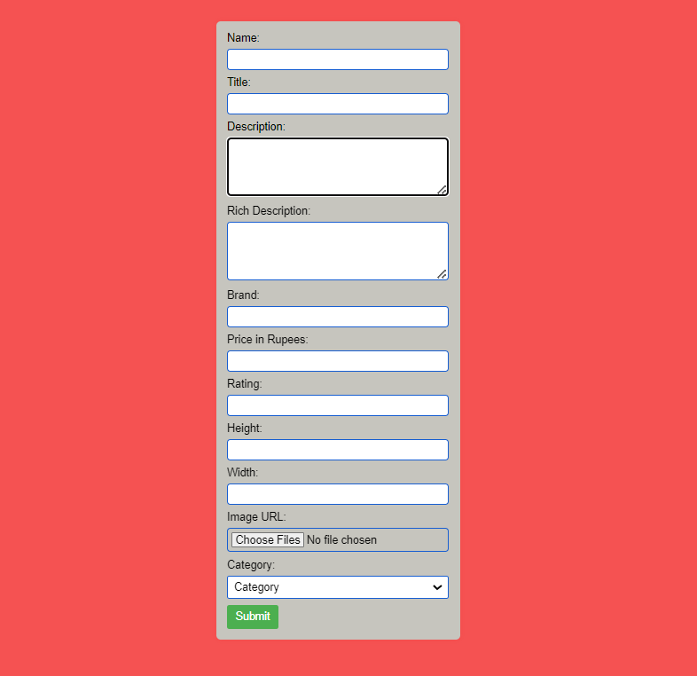
Admin add Product page

Slide 16
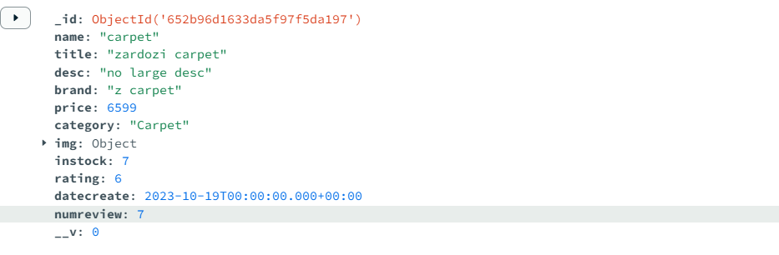
Above admin add product page add new product after complete the above process and the data of this product will saved in mongodb database. All products are add in product section dynamically .

Slide 17

Thanks!
Please keep this slide for attribution

